Slide 1
Lecture 17:
Morphology (ch 7) &
Image Matching (ch 13) ch. 7 and ch. 13 of Machine Vision by Wesley E. Snyder & Hairong Qi
Notes:
Note: To print these slides in grayscale (e.g., on a laser printer), first change the Theme Background to “Style 1” (i.e., dark text on white background), and then tell PowerPoint’s print dialog that the “Output” is “Grayscale.” Everything should be clearly legible then. This is how I also generate the .pdf handouts.

Slide 2
Mathematical Morphology
The study of shape…
Using Set Theory
Most easily understood for binary images.

Slide 3
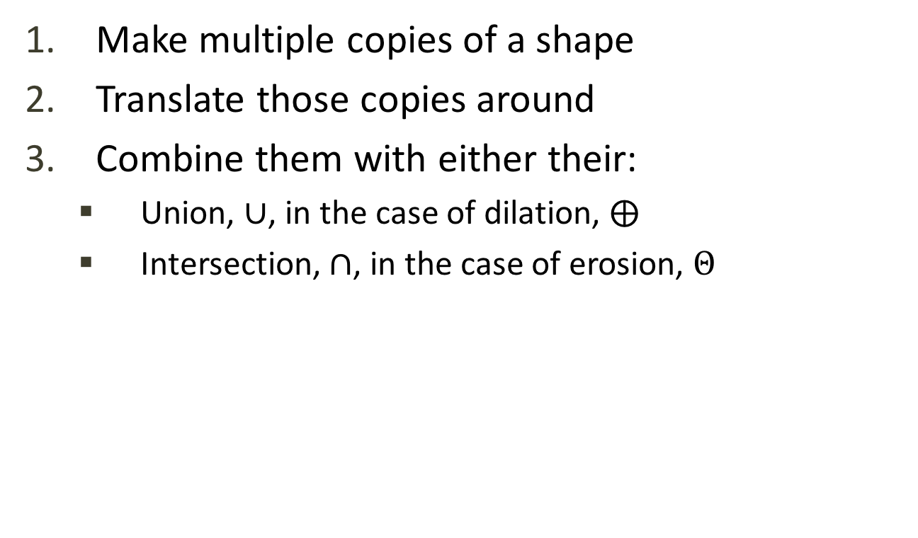
Binary Morphology: Basic Idea
Make multiple copies of a shape
Translate those copies around
Combine them with either their:
  Union, $∪$, in the case of dilation, $⨁$
  Intersection, $∩$, in the case of erosion, $Θ$
Dilation makes things bigger
Erosion makes things smaller

Slide 4
Binary Morphology: Basic Idea
Q: How do we designate:
  The number of copies to make?
  The translation to apply to each copy?
A: With a structuring element (s.e.)
  A (typically) small binary image.
  We will assume the s.e. always contains the origin.
For each marked pixel in the s.e.:
  Make a new copy of the original image
  Translate that new copy by the coordinates of the current pixel in the s.e.
Notes:
Binary image IS a shape

Slide 5

Dilation Example
f_{A}
10
9
8
7
6
5
4
3
2
1
0
 | 0 | 1 | 2 | 3 | 4 | 5 | 6 | 7 | 8 | 9 | 10
f_{B} = s.e.
10
9
8
7
6
5
4
3
2
1
0
 | 0 | 1 | 2 | 3 | 4 | 5 | 6 | 7 | 8 | 9 | 10
3
2
1
0
-1
-2
-3
 | -3 | -2 | -1 | 0 | 1 | 2 | 3
$$⨁$$
=
A = { (2,8),(3,8),(7,8),(8,8),(5,6),(2,4),(3,4),(3,3),(4,3),(5,3),(6,3),(7,3),(7,4),(8,4) }
B = { (0,0),(0,-1) }
Notes:
Intuitively, what happened here?

Slide 6

Erosion Example
For erosion, we translate by the negated coordinates of the current pixel in the s.e.
f_{A}
10
9
8
7
6
5
4
3
2
1
0
 | 0 | 1 | 2 | 3 | 4 | 5 | 6 | 7 | 8 | 9 | 10
10
9
8
7
6
5
4
3
2
1
0
 | 0 | 1 | 2 | 3 | 4 | 5 | 6 | 7 | 8 | 9 | 10
f_{B} = s.e.
10
9
8
7
6
5
4
3
2
1
0
 | 0 | 1 | 2 | 3 | 4 | 5 | 6 | 7 | 8 | 9 | 10
3
2
1
0
-1
-2
-3
 | -3 | -2 | -1 | 0 | 1 | 2 | 3
$$Θ$$
=
=
10
9
8
7
6
5
4
3
2
1
0
 | 0 | 1 | 2 | 3 | 4 | 5 | 6 | 7 | 8 | 9 | 10
Notes:
Intuitively, what happened here?

Slide 7
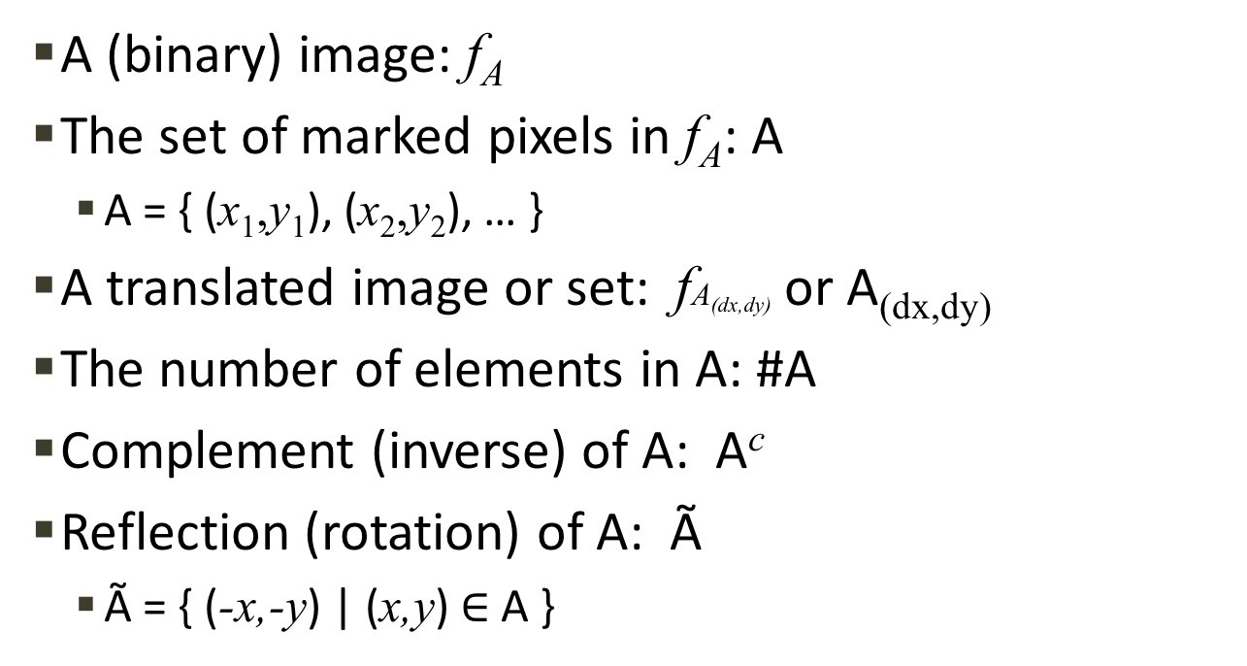
Notation
A (binary) image: f_{A}
The set of marked pixels in f_{A}: A
  A = { (x₁,y₁), (x₂,y₂), … }
A translated image or set: fA_{(dx,dy)} or A_{(dx,dy)}
The number of elements in A: #A
Complement (inverse) of A: A^{c}
Reflection (rotation) of A: Ã
  Ã = { (-x,-y) | (x,y) $∈$ A }
2
1
0
-1
-2
 | -2 | -1 | 0 | 1 | 2
2
1
0
-1
-2
 | -2 | -1 | 0 | 1 | 2

Slide 8
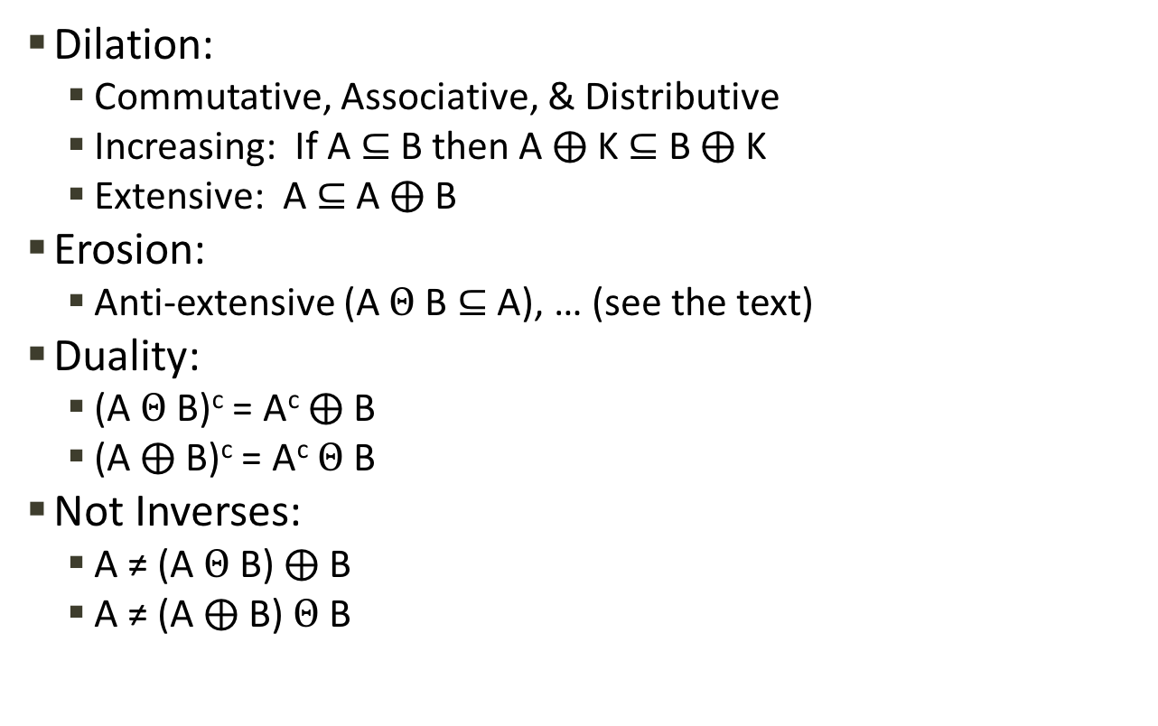
Properties
Dilation:
  Commutative, Associative, & Distributive
  Increasing: If A$⊆$B then A $⨁$K $⊆$ B $⨁$K
  Extensive: A $⊆$ A $⨁$B
Erosion:
  Anti-extensive (A $Θ$B $⊆$ A), … (see the text)
Duality:
  (A $Θ$ B)^{c} = A^{c} $⨁$ B
  (A $⨁$ B)^{c} = A^{c} $Θ$ B
Not Inverses:
  A ≠ (A $Θ$B) $⨁$B
  A ≠ (A $⨁$B) $Θ$B
~
This is actually the
opening of A by B
~
This is actually the
closing of A by B

Slide 9
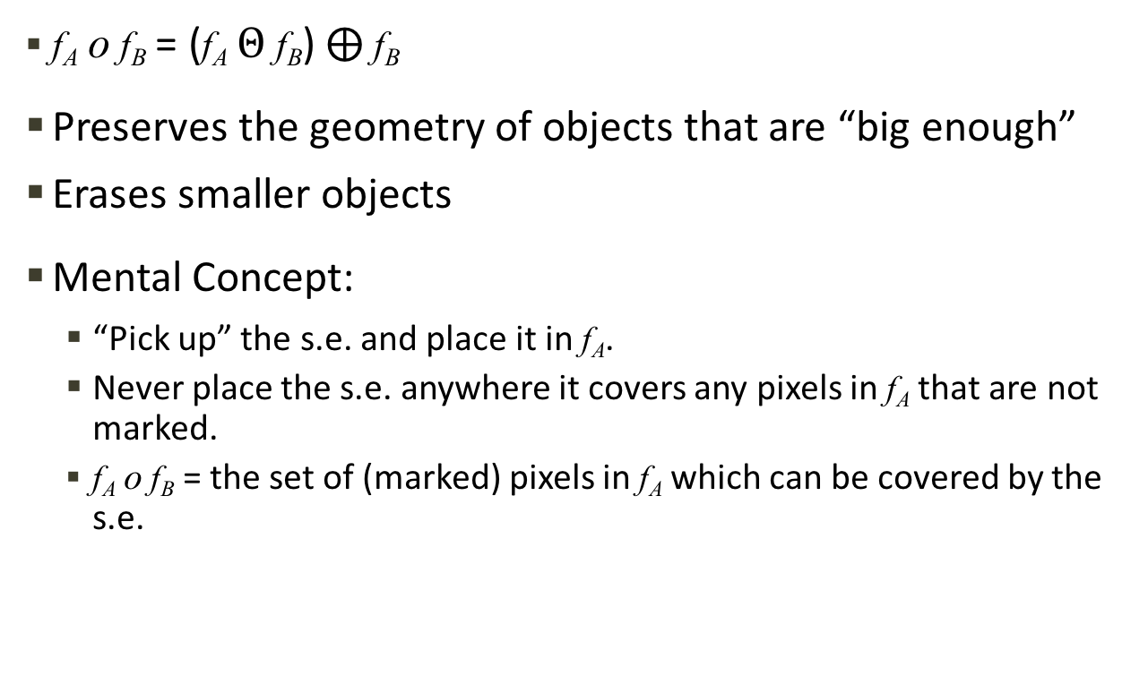
Opening
f_{A} o f_{B} = (f_{A} $Θ$ f_{B}) $⨁$ f_{B}
Preserves the geometry of objects that are “big enough”
Erases smaller objects
Mental Concept:
  “Pick up” the s.e. and place it in f_{A}.
  Never place the s.e. anywhere it covers any pixels in f_{A} that are not marked.
  f_{A} o f_{B} = the set of (marked) pixels in f_{A} which can be covered by the s.e.

Slide 10
Opening Example
Use a horizontal s.e. to remove 1-pixel thick vertical structures:
1
0
-1
 | -1 | 0 | 1
10
9
8
7
6
5
4
3
2
1
0
 | 0 | 1 | 2 | 3 | 4 | 5 | 6 | 7 | 8 | 9 | 10
10
9
8
7
6
5
4
3
2
1
0
 | 0 | 1 | 2 | 3 | 4 | 5 | 6 | 7 | 8 | 9 | 10
10
9
8
7
6
5
4
3
2
1
0
 | 0 | 1 | 2 | 3 | 4 | 5 | 6 | 7 | 8 | 9 | 10
Erosion
Dilation

Slide 11
Gray-Scale Morphology
Morphology operates on sets
Binary images are just a set of marked pixels
Gray-scale images contain more information
How can we apply morphology to this extra intensity information?
We need to somehow represent intensity as elements of a set

Slide 12
The Umbra
Gray-scale morphology operates on the umbra of an image.
Imagine a 2D image as a pixilated surface in 3D
We can also “pixilate” the height of that surface
The 2D image is now a 3D surface made of 3D cells
5
4
3
2
1
0
 | 0 | 1 | 2 | 3 | 4 | 5 | 6 | 7 | 8 | 9 | 10
The umbra of a 1D image
2
1
0
 | -2 | -1 | 0 | 1 | 2
The umbra of a 1D s.e.
5
4
3
2
1
0
 | 0 | 1 | 2 | 3 | 4 | 5 | 6 | 7 | 8 | 9 | 10
Dilation

Slide 13
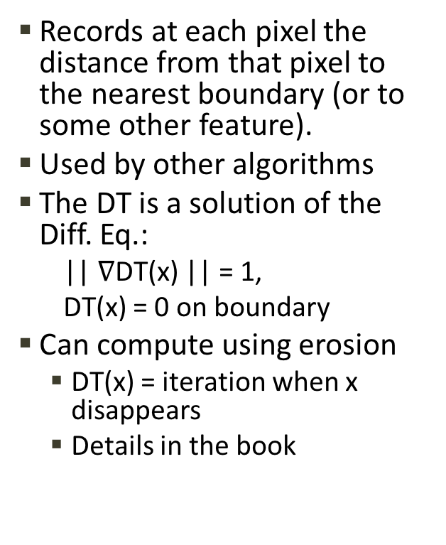
The Distance Transform (DT)
Records at each pixel the distance from that pixel to the nearest boundary (or to some other feature).
Used by other algorithms
The DT is a solution of the Diff. Eq.:
  || $∇$DT(x) || = 1,
  DT(x) = 0 on boundary
Can compute using erosion
  DT(x) = iteration when x disappears
  Details in the book
 | 1 |  |  |  |  | 1 | 1
 | 1 |  |  |  |  | 1 | 1
 | 1 | 1 | 1 |  | 1 | 2 | 1
 | 1 | 2 | 2 | 1 | 2 | 2 | 1
 |  | 1 | 2 | 2 | 3 | 2 | 1
 |  | 1 | 2 | 3 | 2 | 2 | 1
 |  | 1 | 2 | 2 | 1 | 2 | 1
 |  | 1 | 2 | 1 |  | 1 | 1
 |  |  | 1 |  |  | 1
 |  |  | 1
DT of a region’s interior

Slide 14
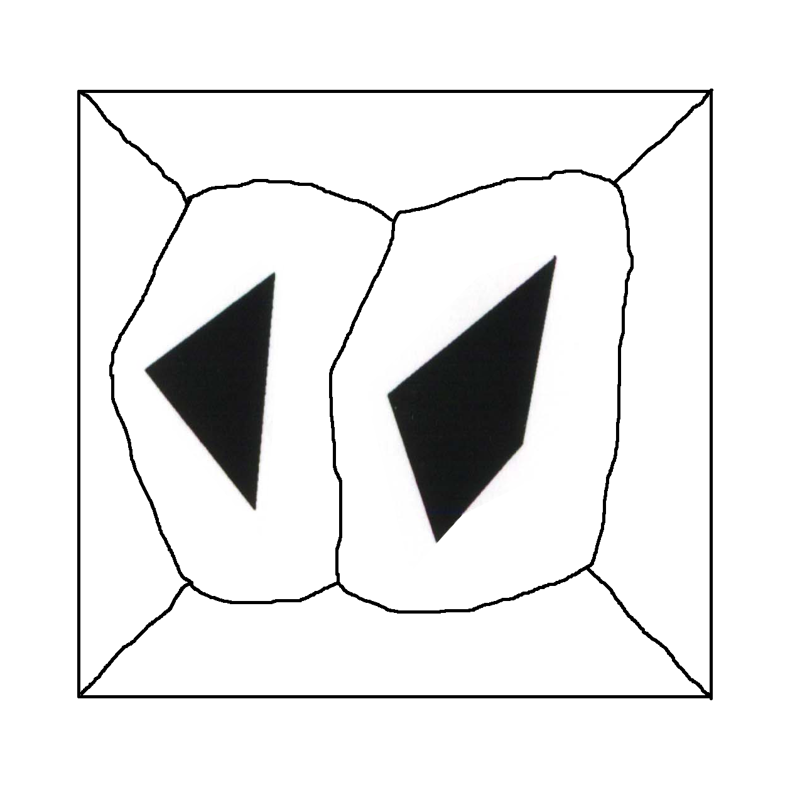
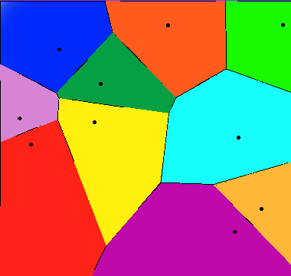
Voronoi Diagram
Divides space
Related to DT
Q: To which of a set of regions (or points) is this point the closest?
Voronoi Diagram’s boundaries = points that are equi-distant from multiple regions
Voronoi Domain of a region = the “cell” of the Voronoi Diagram that contains the region
Details in the text
The voronoi diagram of a set of 10 points is public domain from:
http://en.wikipedia.org/wiki/File:2Ddim-L2norm-10site.png

Slide 15
Imaging Matching (ch. 13)
Matching iconic images
Matching graph-theoretic representations
Most important:
  Eigenimages
  Springs & Templates

Slide 16
Template Matching
Template ≈ a relatively small reference image for some feature we expect to see in our input image.
Typical usage: Move the template around the input image, looking for where it “matches” the best (has the highest correlation).
Rotation & scale can be problematic
  Often require multiple passes if they can’t be ruled out a-priori
How “big” do we make each template?
  Do we represent small, simple features
  Or medium-size, more complex structures?

Slide 17
Eigenimages
Goal: Identify an image by comparing it to a database of other images
Problem: Pixel-by-pixel comparisons are two expensive to run across a large database
Solution: Use PCA

Slide 18
PCA (K-L Expansion)
y’
y
b₂
b₁
x’
x
Big Picture: Fitting a hyper-ellipsoid & then (typically) reducing dimensionality by flattening the shortest axes
Same as fitting an (N+1)-dimensional multivariate Gaussian, and then taking the level set corresponding to one standard deviation
Mathematically, PCA reduces the dimensionality of data by mapping it to the first n eigenvectors (principal components) of the data’s covariance matrix
The first principal component is the eigenvector with the largest eigenvalue and corresponds to the longest axis of the ellipsoid
The variance along an eigenvector is exactly the eigenvector’s eigenvalue
This is VERY important and VERY useful. Any questions?
Notes:
Karhunen–Loève
The book provides more detail
probably discuss more when do Cootes & Taylor ASM.

Slide 19
Eigenimages: Procedure
Run PCA on the training images
  See the text for efficiency details
Store in the database:
  The set of dominant Eigenvectors
    = the principle components
    = the Eigenimages
  For each image, store its coefficients when projected onto the Eigenimages
Match a new image:
  Project it onto the basis of the Eigenimages
  Compare the resulting coefficients to those stored in the database.

Slide 20
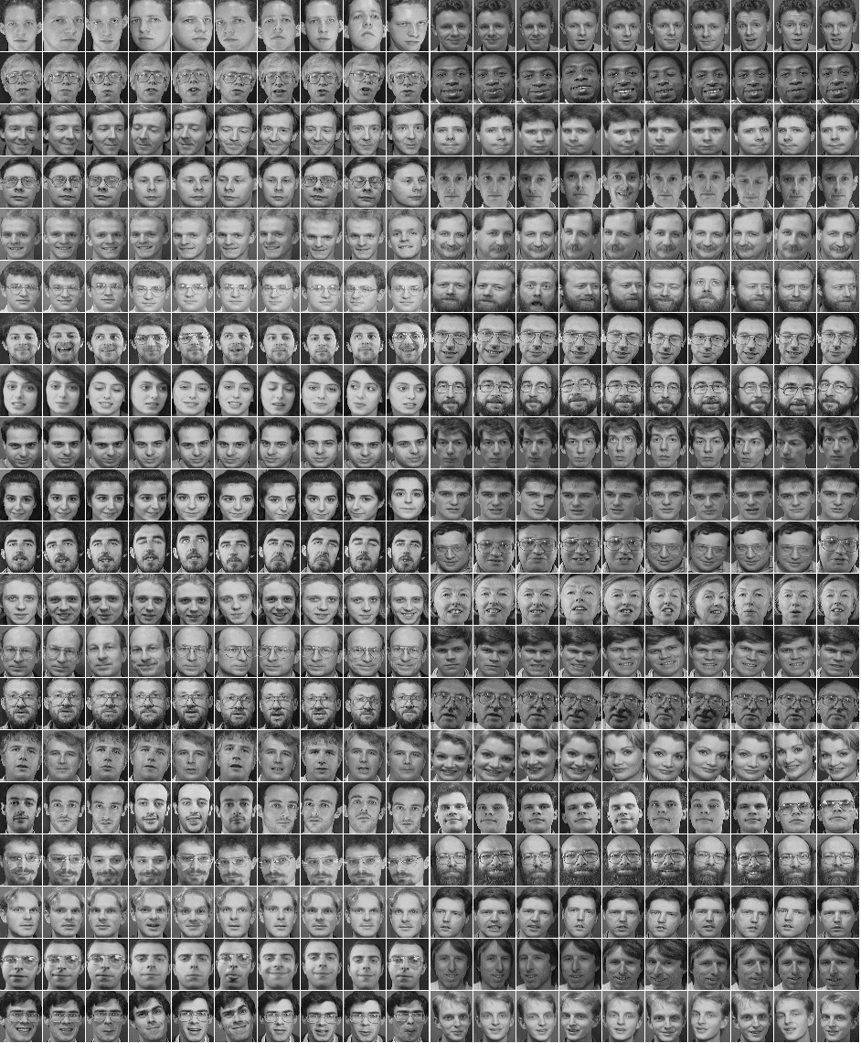
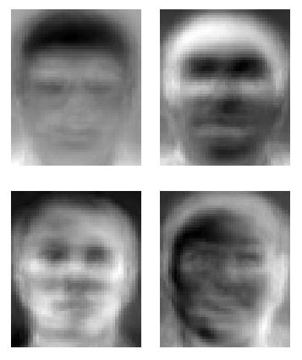


Eigenimages Example
Training Images
Eigenimages / Eigenfaces
PCA
Project Onto
Which training image(s) does each face most resemble?
New
Images:
The face database and the derived Eigenface examples are all from AT&T Laboratories Cambridge:
http://www.cl.cam.ac.uk/research/dtg/attarchive/facedatabase.html & http://en.wikipedia.org/wiki/File:Eigenfaces.png

Slide 21
Matching Simple Features
Classification based on features
  Ex: mean intensity, area, aspect ratio
Idea:
  Combine a set of shape features into a single feature vector
  Build a statistical model of this feature vector between and across object classes in a sequence of training shapes
  Classification of a new shape = the object class from which the new shape’s feature vector most likely came.
Notes:
We’ll discuss shape features in a future lecture.

Slide 22
Graph Matching:
Association Graphs
Match nodes of model to segmented patches in image
Maximal cliques represent the most likely correspondences
  Clique = a totally connected subgraph
Problems: Over/under segmentation, how to develop appropriate rules, often > 1 maximal clique
3B
2B
A
1
B
2
1A
C
3
2C
3C
Image
Model
One of two maximal cliques
Notes:
“A” and “1” are the only spherical objects, so there is no ambiguity there
All other objects are cylindrical, and could match in multiple ways

Slide 23
Graph Matching:
Springs & Templates
Idea: When matching simple templates, we usually expect a certain arrangement between them.
So, arrange templates using a graph structure.
The springs are allowed to deform, but only “so” much.
Top of head
Left
edge
Eye
Eye
Right
edge
Nose
Mouth
Fischler and Elschlager’s “Pictorial Structures” spring & template model for image matching from the early 1970s

Slide 24
Graph Matching:
Springs & Templates
A match is based on minimizing a total cost.
Problem: Making sure missing a point doesn’t improve the score.

