Slide 1
Medical Imaging Modalities
Notes:
Note: To print these slides in grayscale (e.g., on a laser printer), first change the Theme Background to “Style 1” (i.e., dark text on white background), and then tell PowerPoint’s print dialog that the “Output” is “Grayscale.” Everything should be clearly legible then. This is how I also generate the .pdf handouts.

Slide 2
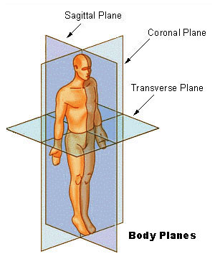
Anatomical Axes
Superior = head
Inferior = feet
Anterior = front
Posterior = back
Proximal = central
Distal = peripheral
Notes:
Diagram is public domain, from http://commons.wikimedia.org/wiki/File:BodyPlanes.jpg from http://training.seer.cancer.gov/module_anatomy/unit1_3_terminology2_planes.html

Slide 3
Imaging Modalities
Camera: Microscope, Endoscope, etc.
X-Ray
CT
Nuclear Medicine
Ultrasound
MRI
…
Notes:
IMAGE = Simultaneous measurements on a spatial grid
mainly EM radiation and sound

Slide 4
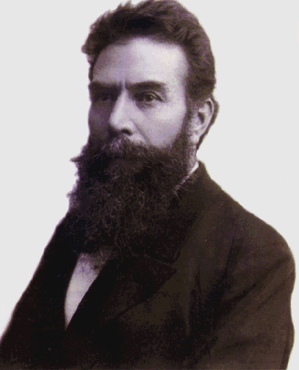
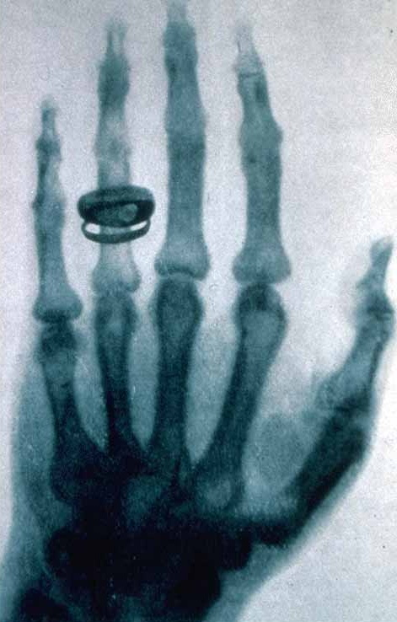
1896: The X-Ray
Notes:
Wilhelm Röntgen's first "medical" x-ray, of his wife's hand, taken on 22 December 1895
(rĕnt'gən, pronounce like “want”, but with an R)
Left Image is public domain from: http://imagine.gsfc.nasa.gov/docs/people/Wilhelm_Roentgen.html
Right Image is expired-copyright public domain from: http://en.wikipedia.org/wiki/File:Roentgen-x-ray-von-kollikers-hand.jpg

Slide 5
X-Ray & Fluoroscopic Images
Projection of X-Ray silhouette onto a detector
Measures densities
3D maps to 2D
Detectors often use an intervening fluorescent screen to convert X-rays to visible light
Fat, muscle, bone, contrast agent, metal
X-Ray Source
Patient
Bone
Detector

Slide 6
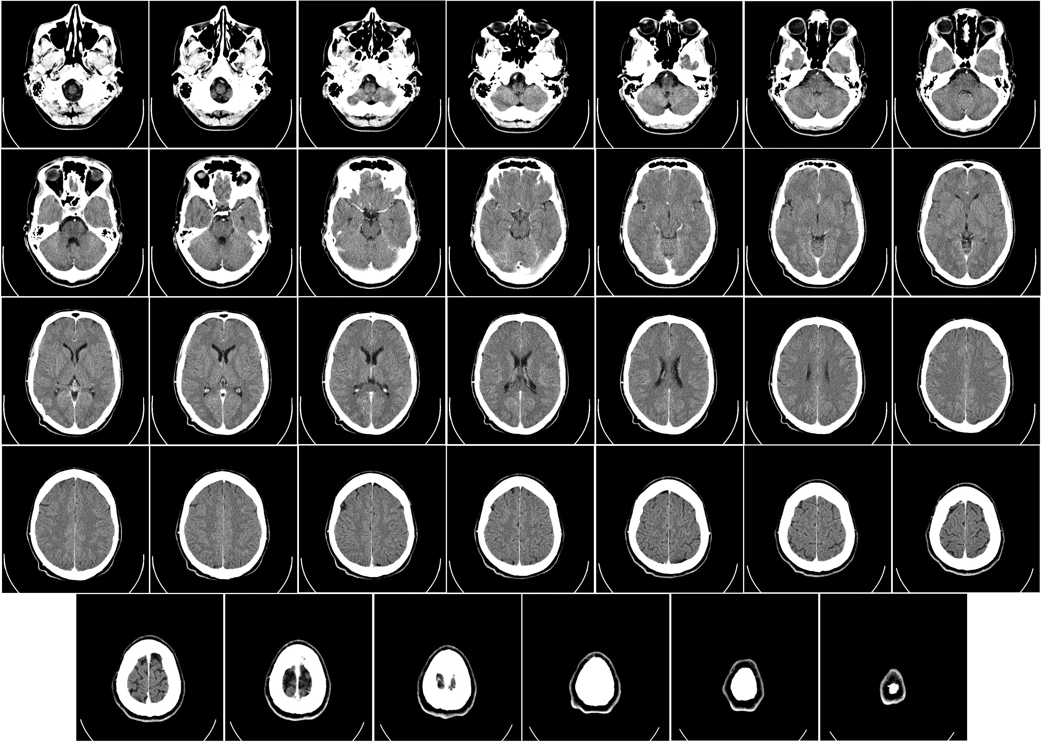
Computerized Tomography
Mikael Häggström’s CT of the human brain with intravenous contrast

Slide 7
Computerized Tomography
X-Ray Source
Spins
around
patient
Patient
Bone
Detector
Spin X-Ray source/detector around the patient
From a series of projections, a tomographic image is reconstructed using Filtered Back Projection.
Notes:
“Medical systems generally use the Hounsfield Unit (HU), in which air is given a CT number of -1000 and water is given a value of 0, causing most soft tissues to have values ranging from -100 to 100 and bone to range from 600 to over 2000” (quoted from http://www.ctlab.geo.utexas.edu/overview/index.php which in turn quotes Zatz, L.M., 1981. Basic principles of computed tomography scanning. In: T.H. Newton, D.G. Potts, (Eds.), Technical Aspects of Computed Tomography. Mosby, St. Louis, pp. 3853-3876.).

Slide 8
Nuclear Medicine
Previously discussed imaging modalities image anatomy (structure).
Nuclear medicine images physiology (function)
  At the cellular (and subcellular) level
  Technically a type of molecular imaging
  Requires use of radioactive pharmaceuticals

Slide 9
SPECT
Array of Gamma Detectors
Array of Lead Collimators
Spins
around
patient
Patient
Radioactive
Target
Single Photon Emission Computed Tomography
Gamma camera for creating image of radioactive target
Camera is rotated around patient

Slide 10
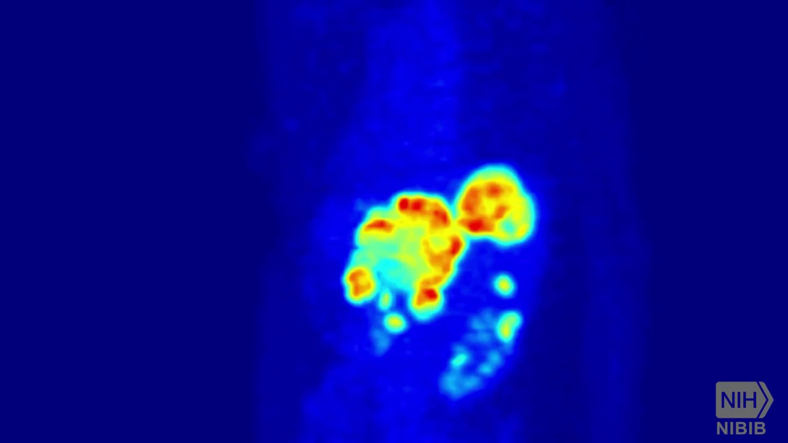
Positron Emission Tomography (PET)
National Institute of Health’s National Institute of Biomedical Imaging and Bioengineering
60 Seconds of Science: How Does a PET Scan Work? CC By License; Music by Longzijun

Slide 11
Positron Emission Tomography
Detectors
When emitted positrons
collide with electrons,
their annihilation sends
2 high-energy photons
off in opposite directions
+
-
Patient
Positron-emitting organic compounds create pairs of high energy photons that are detected synchronously.
No collimators, greater sensitivity.
Attenuation is not location dependent, so quantification is possible.

Slide 12
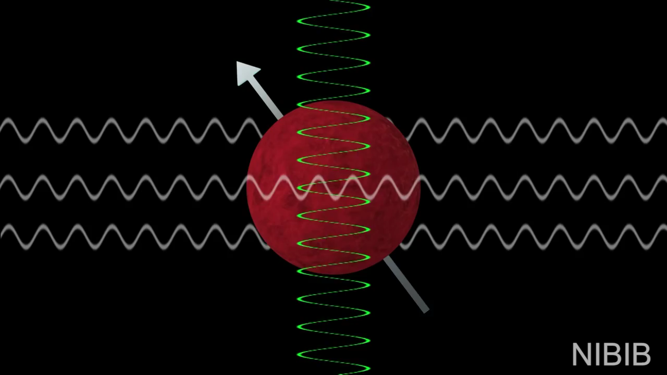
MRI
National Institute of Health’s National Institute of Biomedical Imaging and Bioengineering
60 Seconds of Science: How Does an MRI Work? CC By License; Music by Longzijun

Slide 13
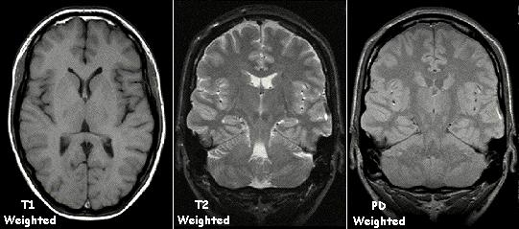
MRI
Kieran Maher’s examples of T1 weighted, T2 weighted, and PD weighted MRI
T1: Bright = Short T1 = Tissue rapidly returns to pre-RF magnetization along z-axis
T2: Bright = Long T2 = Tissue maintains transverse (xy) magnetization long after RF pulse
PD: Proton Density, great for imaging joints, for brain T2-FLAIR is now more common
*-FLAIR: Long inversion time blocks signal from CSF in brain (CSF dark instead of bright)
See also: http://mriquestions.com/meaning-of-weighting.html

Slide 14
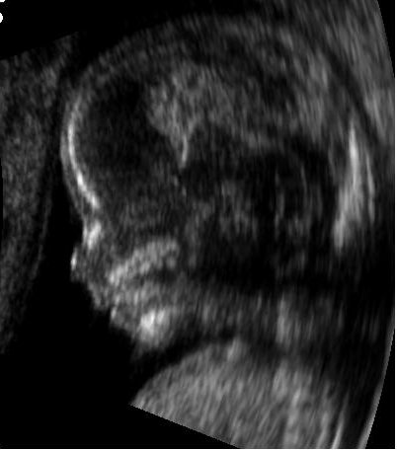
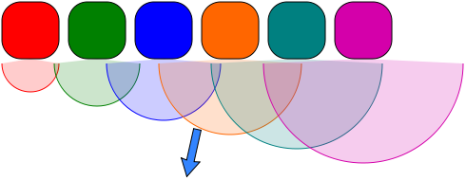
Phased Array Ultrasound
Images anatomy
Ultrasound beam formed and steered by controlling the delay between the elements of the transducer array

Slide 15
Real Time 3D Ultrasound

Slide 16
Other Imaging Modalities
MRI & fMRI details (saved for another lecture)
OCT (“optical ultrasound”)
Pathology (in addition to Radiology)
Other modalities coming down the pike

Slide 17
Current Trends in Imaging
3D, 4D, …
Higher speed
Greater resolution
Measure function as well as structure
Combining modalities (including direct vision)

Slide 18
The Gold Standard
Dissection:
  Medical School, Day 1: Meet the Cadaver.
  From Vesalius to the Visible Human

