Slide 1
Lecture 7—Image Relaxation: Restoration and Feature Extraction ch. 6 of Machine Vision by Wesley E. Snyder & Hairong Qi
Notes:
Note: To print these slides in grayscale (e.g., on a laser printer), first change the Theme Background to “Style 1” (i.e., dark text on white background), and then tell PowerPoint’s print dialog that the “Output” is “Grayscale.” Everything should be clearly legible then. This is how I also generate the .pdf handouts.

Slide 2
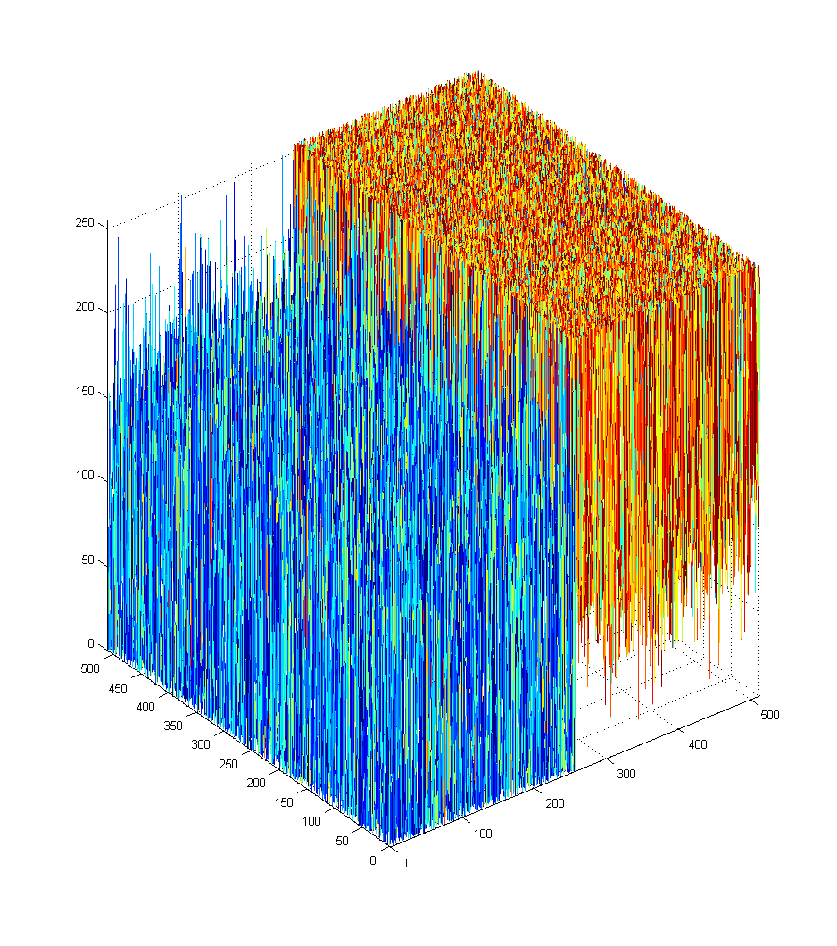
All images are degraded
Remember, all measured images are degraded
Noise (always)
Distortion = Blur (usually)
False edges
From noise
Unnoticed/Missed edges
From noise + blur
original
image
plot
noisy
image
plot

Slide 3
We need an “un-degrader”…
To extract “clean” features for segmentation, registration, etc.
Restoration
A-posteriori image restoration
Removes degradations from images
Feature extraction
Iterative image feature extraction
Extracts features from noisy images

Slide 4
Image relaxation
The basic operation performed by:
Restoration
Feature extraction (of the type in ch. 6)
An image relaxation process is a multistep algorithm with the properties that:
The output of a step is the same form as the input (e.g., 256² image to 256² image)
Allows iteration
It converges to a bounded result
The operation on any pixel is dependent only on those pixels in some well defined, finite neighborhood of that pixel. (optional)

Slide 5
Restoration: An inverse problem
This is
what we
want
Assume:
An ideal image, f
A measured image, g
A distortion operation, D
Random noise, n
Put it all together:
g = D( f ) + n
This is
what we
get
How do we
extract f ?

Slide 6
Restoration is ill-posed
Even without noise
Even if the distortion is linear blur
Inverting linear blur = deconvolution
But we want restoration to be well-posed…

Slide 7
A well-posed problem
g = D( f ) is well-posed if:
For each f, a solution exists,
The solution is unique, AND
The solution g continuously depends on the data f
Otherwise, it is ill-posed
Usually because it has a large condition number:
K >> 1
Notes:
** Important for Registration **

Slide 8
Condition number, K
K ≈ Δ output / Δ input
For the linear system b = Ax
K = ||A|| ||A⁻¹||
K ∈ [1,∞)

Slide 9
K for convolved blur
Why is restoration ill-posed for simple blur?
Why not just linearize a blur kernel, and then take the inverse of that matrix?
F = H⁻¹G
Because H is probably singular
If not, H almost certainly has a large K
So small amounts of noise in G will make the computed F almost meaningless
See the book for great examples

Slide 10
Regularization theory to the rescue!
How to handle an ill-posed problem?
Find a related well-posed problem!
One whose solution approximates that of our ill-posed problem
E.g., try minimizing:
But unless we know something about the noise, this is the exact same problem!

Slide 11
Digression: Statistics
Remember Bayes’ rule?
p( f | g ) = p( g | f ) * p( f ) / p( g )
This is the
a posteriori
conditional
pdf
This is the
conditional
pdf
Just a
normalization
constant
This is the
a priori pdf
This is what we want!
It is our discrimination
function.

Slide 12
Maximum a posteriori (MAP) image processing algorithms
To find the f underlying a given g:
Use Bayes’ rule to “compute all” p( f_{q} | g )
f_{q} ∈ (the set of all possible f )
Pick the f_{q} with the maximum p( f_{q} | g )
p( g ) is “useless” here (it’s constant across all f_{q})
This is equivalent to:
f = argmax( f_{q}) p( g | f_{q} ) * p( f_{q} )
Noise term
Prior term

Slide 13
Probabilities of images
Based on probabilities of pixels
For each pixel i:
p( f_{i} | g_{i} ) ∝ p( g_{i} | f_{i} ) * p( f_{i} )
Let’s simplify:
Assume no blur (just noise)
At this point, some people would say we are denoising the image.
p( g | f ) = ∏ p( g_{i} | f_{i} )
p( f ) = ∏ p( f_{i} )

Slide 14
Probabilities of pixel values
p( g_{i} | f_{i} )
This could be the density of the noise…
Such as a Gaussian noise model
= constant * e^{something}
p( f_{i} )
This could be a Gibbs distribution…
If you model your image as an ND Markov field
= e^{something}
See the book for more details

Slide 15
Put the math together
Remember, we want:
f = argmax( f_{q}) p( g | f_{q} ) * p( f_{q} )
where f_{q} ∈ (the set of all possible f )
And remember:
p( g | f ) = ∏ p( g_{i} | f_{i} ) = constant * ∏ e^{something}
p( f ) = ∏ p( f_{i} ) = ∏ e^{something}
where i ∈ (the set of all image pixels)
But we like ∑something better than ∏e^{something}, so take the log and solve for:
f = argmin( f_{q}) ( ∑ p’ ( g_{i} | f_{i} ) + ∑ p’( f_{i} ) )

Slide 16
Objective functions
We can re-write the previous slide’s final equation to use objective functions for our noise and prior terms:
f = argmin(f_{q}) ( ∑ p’( g_{i} | f_{i} ) + ∑ p’( f_{i} ) )
⇓
f = argmin(f_{q}) ( H_{n}( f, g ) + H_{p}( f ) )
We can also combine these objective functions:
H( f, g ) = H_{n}( f, g ) + H_{p}( f )

Slide 17
Purpose of the objective functions
Noise term H_{n}( f, g ):
If we assume independent, Gaussian noise for each pixel,
We tell the minimization that f should resemble g.
Prior term (a.k.a. regularization term) H_{p}( f ):
Tells the minimization what properties the image should have
Often, this means brightness that is:
Constant in local areas
Discontinuous at boundaries

Slide 18
Minimization is a beast!
Our objective function is not “nice”
It has many local minima
So gradient descent will not do well
We need a more powerful optimizer:
Mean field annealing (MFA)
Approximates simulated annealing
But it’s faster!
It’s also based on the mean field approximation of statistical mechanics

Slide 19
MFA
MFA is a continuation method
So it implements a homotopy
A homotopy is a continuous deformation of one hyper-surface into another
MFA procedure:
Distort our complex objective function into a convex hyper-surface (N-surface)
The only minima is now the global minimum
Gradually distort the convex N-surface back into our objective function

Slide 20
MFA: Single-Pixel Visualization
0.3
0.2
0.1
0 |  | 20 |  | 40 |  | 60 |  | 80 |  | 100
Notice that
we do not
end up here
or here
merit
of each
possible
pixel
value
initial
global
minimum
final
global
minimum
possible values
for a single pixel
Continuous deformation of a function which is initially convex to find the (near-) global minimum of a non-convex function.

Slide 21
Generalized objective functions for MFA
Noise term:
(D( f ))_{i} denotes some distortion (e.g., blur) of image f in the vicinity of pixel I
Prior term:
τ represents a priori knowledge about the roughness of the image, which is altered in the course of MFA
(R( f ))_{i} denotes some function of image f at pixel i
The prior will seek the f which causes R( f ) to be zero (or as close to zero as possible)

Slide 22
R( f ): choices, choices
Piecewise-constant images
=0 if the image is constant
≈ 0 if the image is piecewise-constant (why?)
The noise term will force a piecewise-constant image
Notes:
Derivative = 0 almost everywhere

Slide 23
R( f ): Piecewise-planer images
=0 if the image is a plane
≈ 0 if the image is piecewise-planar
The noise term will force a piecewise-planar image
Notes:
Clearly a better fit
(but not necessarily for, e.g., CT)

Slide 24
Graduated nonconvexity (GNC)
Similar to MFA
Uses a descent method
Reduces a control parameter
Can be derived using MFA as its basis
“Weak membrane” GNC is analogous to piecewise-constant MFA
But different:
Its objective function treats the presence of edges explicitly
Pixels labeled as edges don’t count in our noise term
So we must explicitly minimize the # of edge pixels

Slide 25
Variable conductance diffusion (VCD)
Idea:
Blur an image everywhere,
except at features of interest
such as edges

Slide 26
VCD simulates the diffusion eq.
temporal
derivative
spatial
derivative
Where:
t = time
∇_{i} f = spatial gradient of f at pixel i
c_{i} = conductivity (to blurring)

Slide 27
Isotropic diffusion
If c_{i} is constant across all pixels:
Isotropic diffusion
Not really VCD
Isotropic diffusion is equivalent to convolution with a Gaussian
The Gaussian’s variance is defined in terms of t and c_{i}

Slide 28
VCD
c_{i} is a function of spatial coordinates, parameterized by i
Typically a property of the local image intensities
Can be thought of as a factor by which space is locally compressed
To smooth except at edges:
Let c_{i} be small if i is an edge pixel
Little smoothing occurs because “space is stretched” or “little heat flows”
Let c_{i} be large at all other pixels
More smoothing occurs in the vicinity of pixel i because “space is compressed” or “heat flows easily”

Slide 29
VCD
A.K.A. Anisotropic diffusion
With repetition, produces a nearly piecewise uniform result
Like MFA and GNC formulations
Equivalent to MFA w/o a noise term
Edge-oriented VCD:
VCD + diffuse tangential to edges when near edges
Biased Anisotropic diffusion (BAD)
Equivalent to MAP image restoration
Notes:
BUT, are the pieces separated where we want?

Slide 30
VCD Sample Images
From the Scientific Applications and Visualization Group at NIST
http://math.nist.gov/mcsd/savg/software/filters/

Slide 31
Various VCD Approaches: Tradeoffs and example images
Mirebeau J., Fehrenbach J., Risser L., Tobji S., “Anisotropic Diffusion in ITK”, the Insight Journal
Images copied per Creative Commons license
http://www.insight-journal.org/browse/publication/953
Then click on the “Download Paper” link in the top-right

Slide 32
Edge Preserving Smoothing
Other techniques constantly being developed (but none is perfect)
E.g., “A Brief Survey of Recent Edge-Preserving Smoothing Algorithms on Digital Images”
https://arxiv.org/abs/1503.07297
SimpleITK filters:
BilateralImageFilter
Various types of AnisotropicDiffusionImageFilter
Various types of CurvatureFlowImageFilter

Slide 33
Congratulations!
You have made it through most of the “introductory” material.
Now we’re ready for the “fun stuff.”
“Fun stuff” (why we do image analysis):
Segmentation
Registration
Shape Analysis
Etc.

